Slide 1


<Name>
<Date>

Slide 2

Outline
Executive Summary
Introduction
Methodology
Results
Conclusion
Appendix

Slide 3
Executive Summary
This capstone project focuses on predicting the successful landing of the SpaceX Falcon 9 first stage using multiple machine learning classification techniques.
The project follows a structured process:
Data collection, preparation, and formatting
Exploratory data analysis
Interactive data visualization
Machine learning modeling and prediction
Our analysis indicates that several launch features are correlated with mission outcomes (success or failure).
Results suggest that the decision tree algorithm performs particularly well for predicting Falcon 9 first-stage landing success.

Slide 4
Introduction
The goal of this capstone is to predict whether the Falcon 9 first stage will land successfully.
SpaceX advertises Falcon 9 launches at $62 million per mission, while competitors charge $165 million or more. The cost advantage largely comes from SpaceX’s ability to reuse the first stage.
By predicting landing success, we can estimate launch costs—insightful for competitors considering bids against SpaceX.
Not all unsuccessful landings indicate failure; in some cases, SpaceX intentionally performs controlled ocean landings.
Key question: Given features such as payload mass, orbit type, and launch site, can we accurately predict whether the Falcon 9 first stage will land successfully?

Slide 5

Section 1

Slide 6
Methodology
Executive Summary
Data collection methodology:
Sourced from spacedata.com API and Wikipedia
Perform data wrangling
Processed using local Jupyter notebooks in Python
Perform exploratory data analysis (EDA) using visualization and SQL
Perform interactive visual analytics using Folium and Plotly Dash
Perform predictive analysis using classification models
Supervised machine learning models from Scikit-Learn package

Slide 7
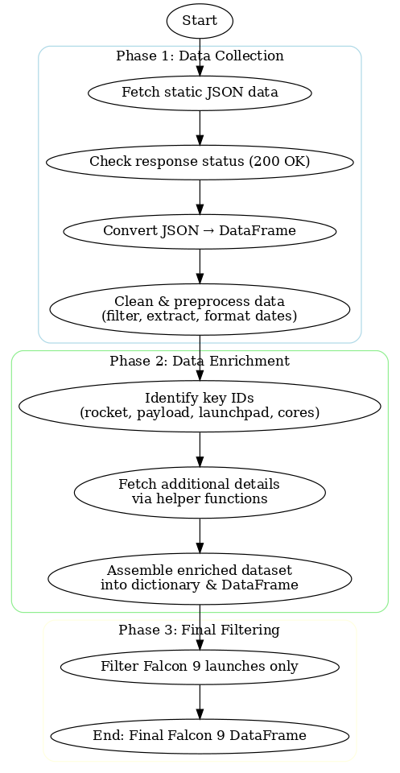
Data Collection – SpaceX API
The API used is https://api.spacexdata.com/v4/rockets/.
Called by “requests” Python package requests.get("https://api.spacexdata.com/v4/payloads/"+load).json()
Code found here: https://github.com/scissory/applied-data-science-capstone/blob/0ac0955b3c9c774e4e400727af61ffc92e43f10b/Data%20Collection%20API.ipynb

Slide 8
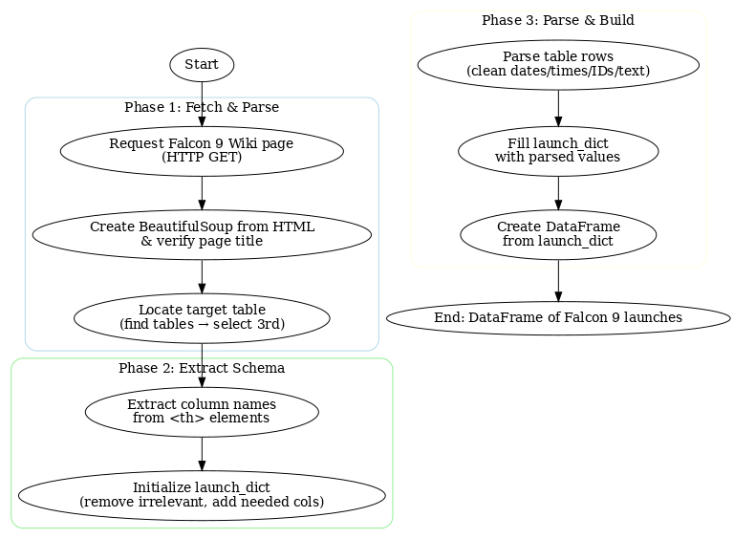
Data Collection - Scraping
Wikipedia page: https://en.wikipedia.org/wiki/List_of_Falcon_9_and_Falcon_Heavy_launches
Using BeautifulSoup package for web scrapping
Code found here: https://github.com/scissory/applied-data-science-capstone/blob/0ac0955b3c9c774e4e400727af61ffc92e43f10b/Data%20Collection%20Web%20Scraping.ipynb

Slide 9
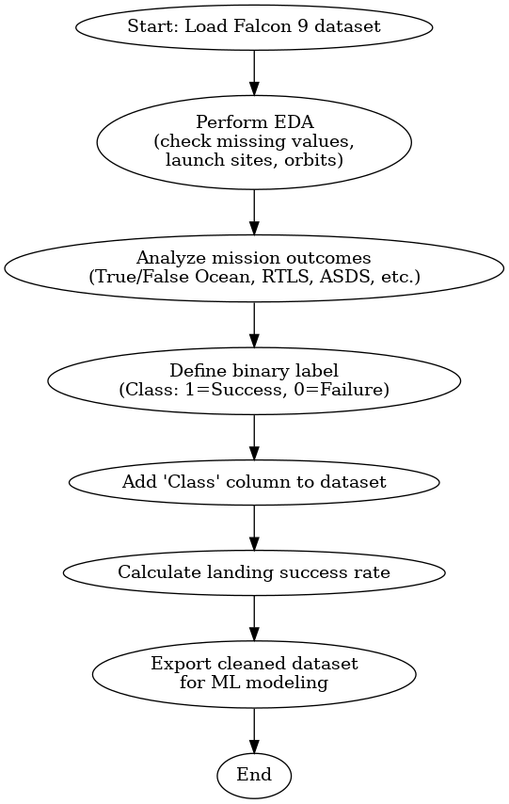
Data Wrangling
Exploratory Data Analysis (EDA): Loaded and examined the SpaceX Falcon 9 dataset, assessed missing values, and analyzed launches by site and orbit types to understand data distribution.
Mission Outcomes & Label Creation: Categorized landing outcomes (e.g., True/False Ocean, RTLS, ASDS) and simplified them into a binary classification label (1 = successful landing, 0 = unsuccessful).
Prepared Dataset for Modeling: Created a new Class column representing landing success, calculated success rates, and exported the cleaned dataset for use in supervised machine learning tasks.
Code found here: https://github.com/scissory/applied-data-science-capstone/blob/e47e4f4d0e8be119f3e5cb0e736579ee4e0d95ee/Data%20Wrangling.ipynb

Slide 10
EDA with Data Visualization
Scatter plots (Flight Number vs. PayloadMass, Launch Site, Orbit): Used to examine how launch frequency, payload size, and different sites/orbits influence landing success. These help identify trends such as higher success with more flight experience and limitations of specific launch sites with heavy payloads.
Bar chart (Orbit vs. Success Rate): Plotted to compare average landing success across orbit types. This visualization highlights which orbits have historically higher or lower success rates.
Line chart (Year vs. Success Rate): Used to show the yearly trend of launch outcomes, demonstrating SpaceX’s improvement in landing success over time, especially post-2013.
Code found here: https://github.com/scissory/applied-data-science-capstone/blob/e47e4f4d0e8be119f3e5cb0e736579ee4e0d95ee/EDA%20Visualization.ipynb

Slide 11
EDA with SQL
Exploration of launch data: Queries retrieve distinct launch sites, filter records by site prefix, and examine payload/booster information (e.g., total and average payload mass for specific customers or booster versions).
Mission outcome analysis: Queries identify first successful landings, count success vs. failure outcomes, and list failed or successful landing cases by year, site, and booster type.
Advanced filtering and ranking: Queries use subqueries and grouping to find boosters with maximum payload mass and to rank landing outcomes between specific dates.
Code found here: https://github.com/scissory/applied-data-science-capstone/blob/e47e4f4d0e8be119f3e5cb0e736579ee4e0d95ee/EDA%20SQL.ipynb

Slide 12
Build an Interactive Map with Folium
Site markers & circles: Added a folium. Circle and text Marker at each launch site to pin exact coordinates and label the site name—this gives quick geographic context and lets you visually compare site locations on the map.
Outcome markers with clustering: Plotted per-launch Markers colored by success (green) or failure (red) and grouped them with MarkerCluster—this reduces clutter at identical coordinates and makes success rates by site easy to spot at a glance.
Distance tools & lines to proximities: Enabled MousePosition to read coordinates, then added distance‐labeled Markers (DivIcon) and PolyLines from a launch site to nearby features (coastline, city, railway, highway)—to assess how proximity to infrastructure or coast might relate to launch operations.
Code found here: https://github.com/scissory/applied-data-science-capstone/blob/e47e4f4d0e8be119f3e5cb0e736579ee4e0d95ee/Folium%20lab.ipynb

Slide 13
Build a Dashboard with Plotly Dash
Interactive inputs (filters): A Launch Site dropdown (including “All Sites”) to switch between global view and a specific site, and a Payload range slider (0–10,000 kg) to focus analyses on chosen payload intervals — both enable quick slicing of the dataset to answer “where/when do we succeed?” questions.
Success distribution pie chart: A pie chart that updates via callback from the site dropdown—showing total successes by site when “All Sites” is selected, or success vs. failure counts for the chosen site—so users can compare which site has the most successes and which has the highest success rate.
Outcome vs. payload scatter plot: A scatter chart filtered by both site and payload range, plotting Payload Mass (x) vs. Launch Outcome/Class (y) and coloring by Booster Version—to visualize how payload correlates with success and to see which booster versions perform best across sites and payloads.
Code found here: https://github.com/scissory/applied-data-science-capstone/blob/e47e4f4d0e8be119f3e5cb0e736579ee4e0d95ee/dashboard%20app.py

Slide 14
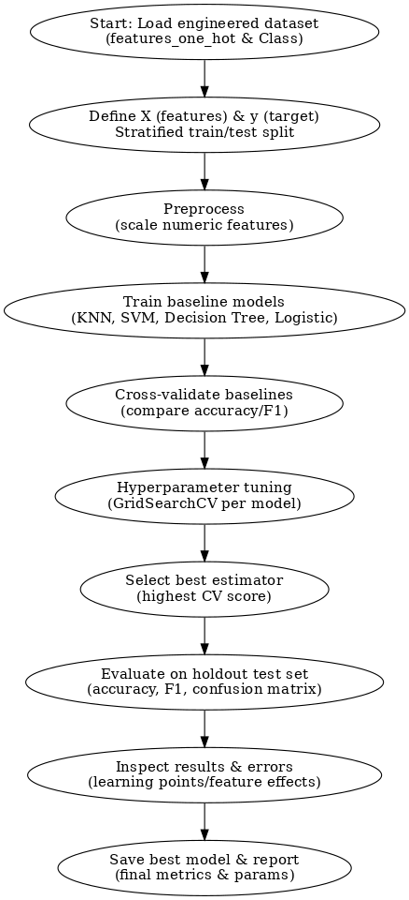
Predictive Analysis (Classification)
Build: Loaded engineered features/labels, performed a stratified train/test split, applied preprocessing (e.g., scaling), and trained multiple baseline classifiers (KNN, SVM, Decision Tree, Logistic Regression).
Evaluate & Improve: Used cross-validation to compare baseline performance, then ran GridSearchCV per model to tune hyperparameters (e.g., k, C, gamma, max_depth) and reduce variance/bias.
Select Best: Chose the best estimator by highest cross-validated score, confirmed on the hold-out test set with metrics (accuracy, F1, confusion matrix), and recorded final parameters/metrics.
Code found here: https://github.com/scissory/applied-data-science-capstone/blob/e47e4f4d0e8be119f3e5cb0e736579ee4e0d95ee/Machine%20Learning%20Prediction.ipynb

Slide 15
Results
Exploratory data analysis results
Interactive analytics demo in screenshots
Predictive analysis results

Slide 16

Section 2

Slide 17
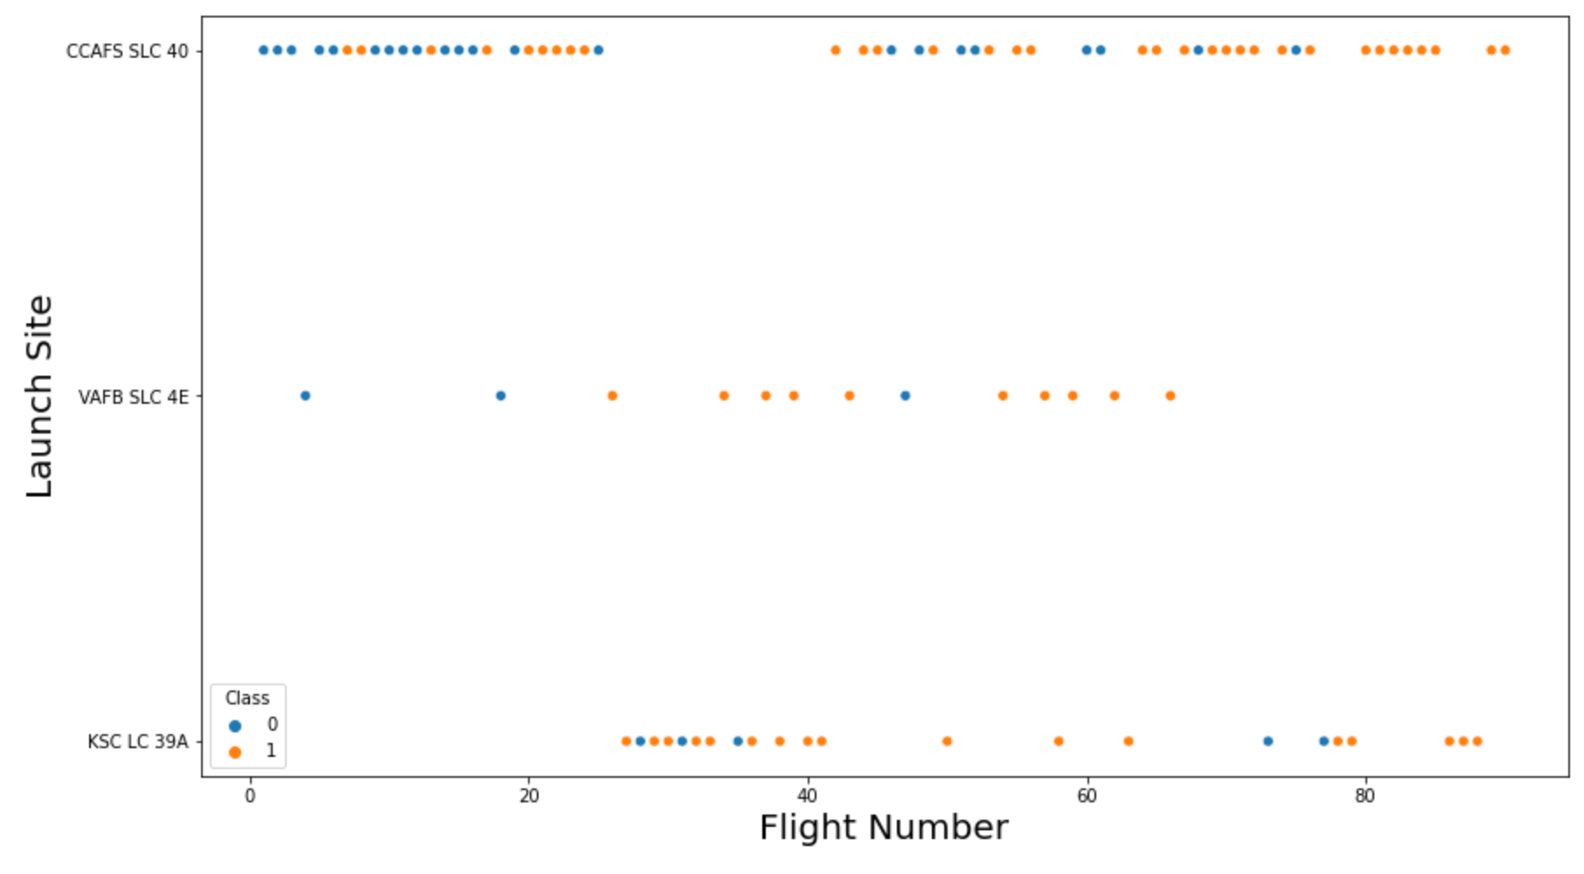
Flight Number vs. Launch Site

Slide 18
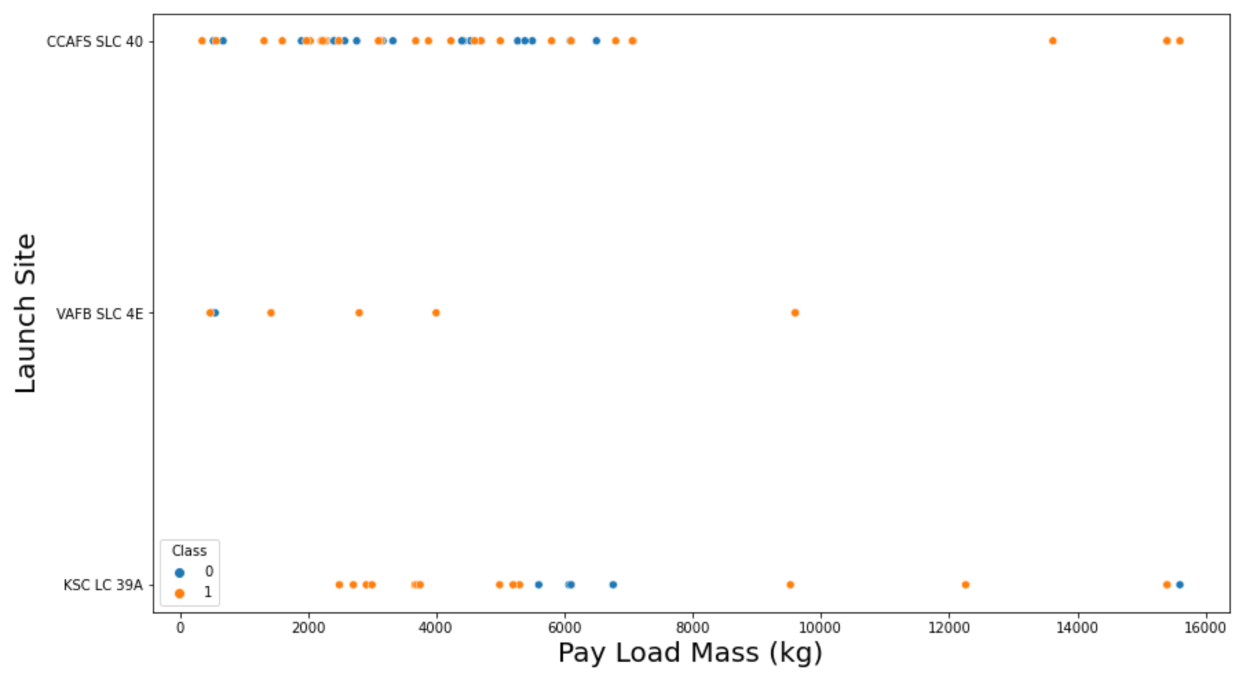
Payload vs. Launch Site

Slide 19
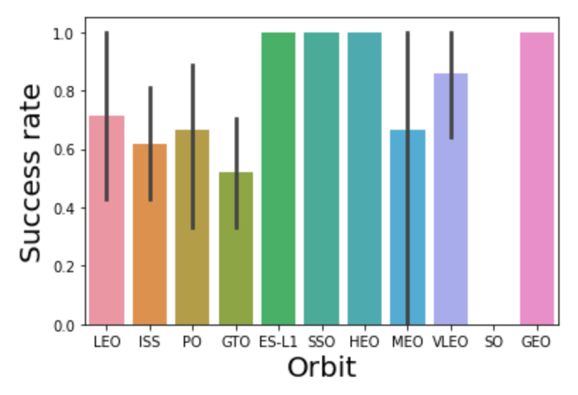
Success Rate vs. Orbit Type

Slide 20
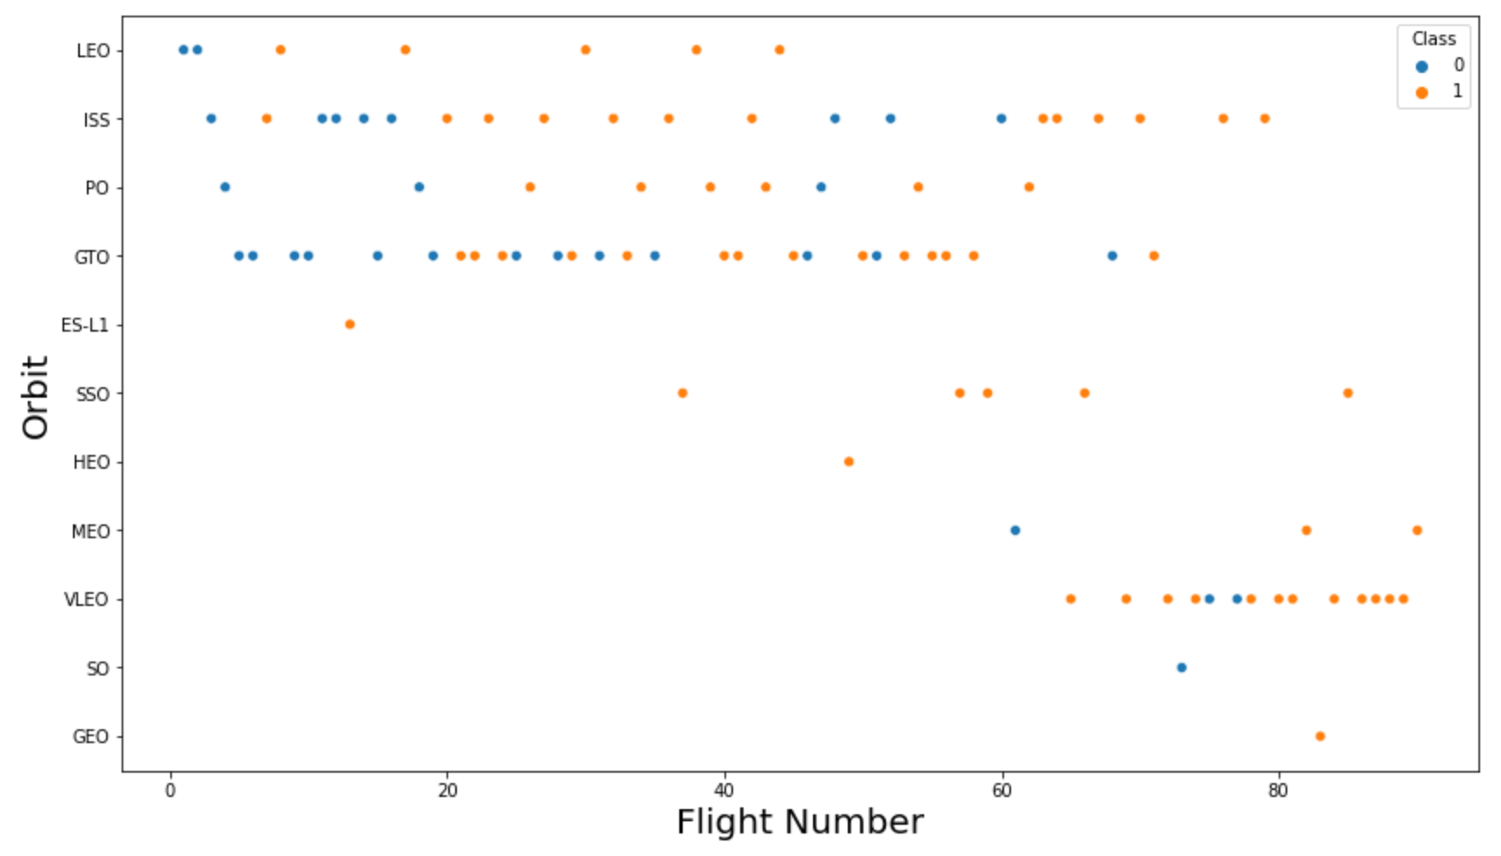
Flight Number vs. Orbit Type

Slide 21
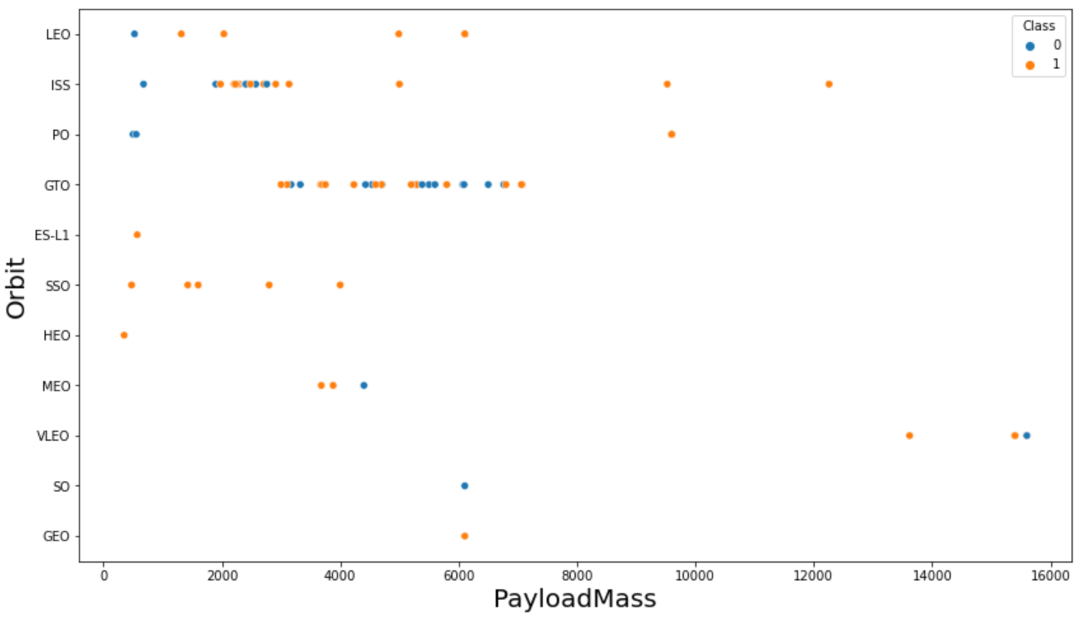
Payload vs. Orbit Type

Slide 22
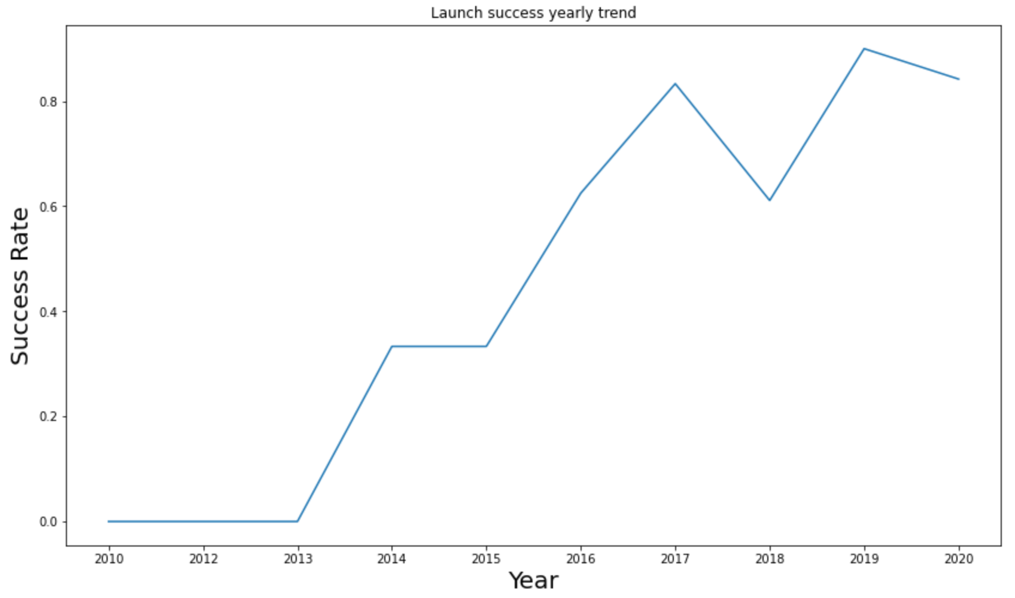
Launch Success Yearly Trend

Slide 23

All Launch Site Names

Slide 24
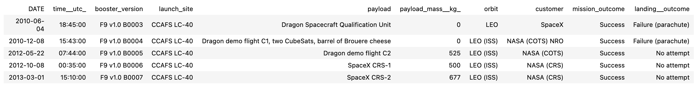
Launch Site Names Begin with 'CCA'
%sql SELECT * FROM SPACEXTBL WHERE LAUNCH_SITE LIKE 'CCA%' LIMIT 5;

Slide 25
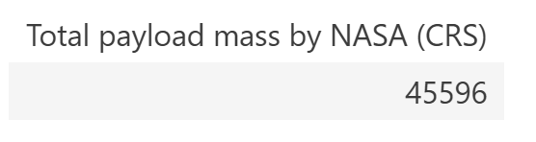
Total Payload Mass

Slide 26
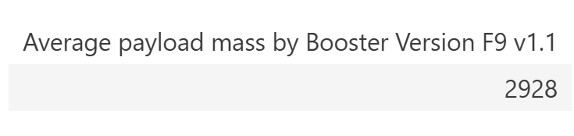
Average Payload Mass by F9 v1.1

Slide 27
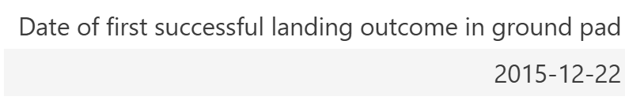
First Successful Ground Landing Date
%sql SELECT MIN(DATE) AS "Date of first successful landing outcome in ground pad" FROM SPACEXTBL WHERE LANDING__OUTCOME = 'Success (ground pad)';

Slide 28
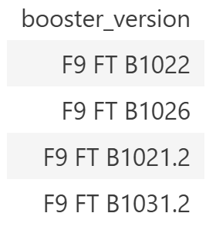
Successful Drone Ship Landing with Payload between 4000 and 6000

Slide 29
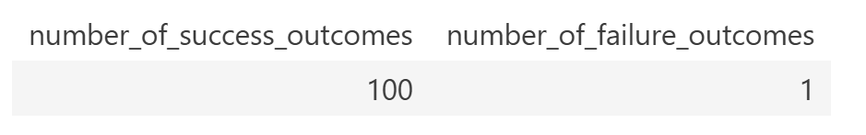
Total Number of Successful and Failure Mission Outcomes
%sql SELECT number_of_success_outcomes, number_of_failure_outcomes FROM (SELECT COUNT(*) AS number_of_success_outcomes FROM SPACEXTBL WHERE MISSION_OUTCOME LIKE 'Success%') success_table, (SELECT COUNT(*) number_of_failure_outcomes FROM SPACEXTBL WHERE MISSION_OUTCOME LIKE 'Failure%') failure_table

Slide 30
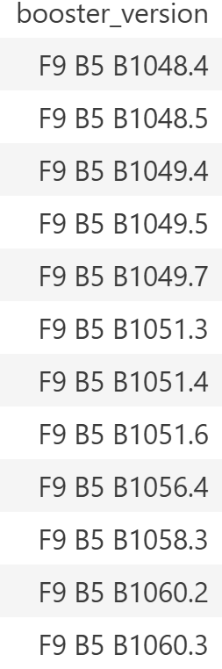
Boosters Carried Maximum Payload
%sql SELECT DISTINCT BOOSTER_VERSION FROM SPACEXTBL WHERE PAYLOAD_MASS__KG_ =(SELECT MAX(PAYLOAD_MASS__KG_) FROM SPACEXTBL);

Slide 31
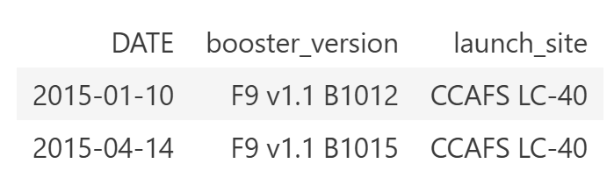
2015 Launch Records

Slide 32
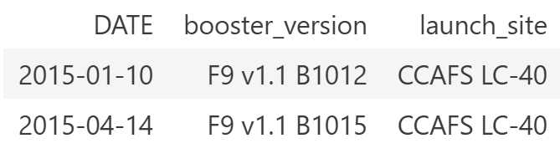
Rank Landing Outcomes Between 2010-06-04 and 2017-03-20

Slide 33

Section 3

Slide 34
All Launch Sites

Slide 35
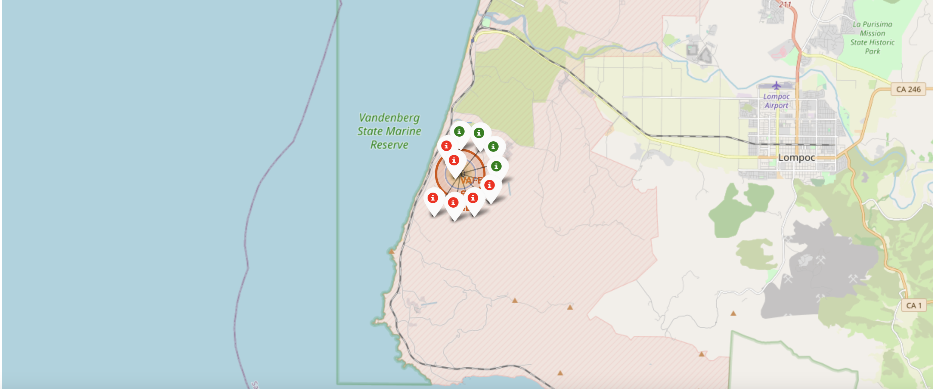
Successful/Failed Launches at Site
The map shows each launch site with markers indicating successful and failed launches.
Zooming into a site reveals color-coded tags: green for success and red for failure.

Slide 36
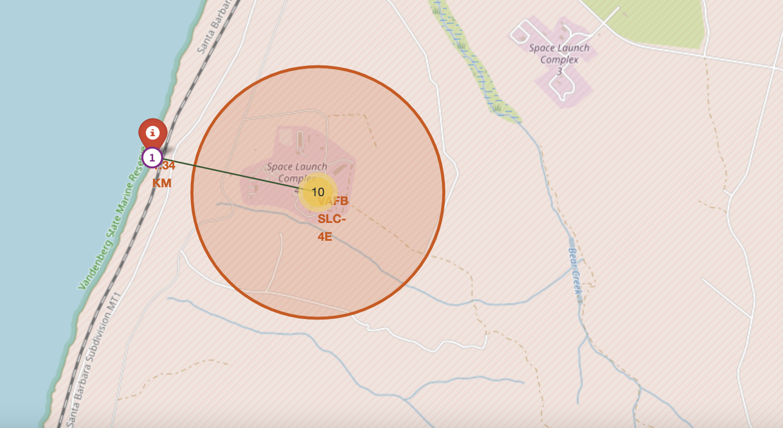
Launch Site Proximity to Cities
The picture above shows the distance between the VAFB SLC-4E launch site and the nearest coastline

Slide 37

Section 4

Slide 38
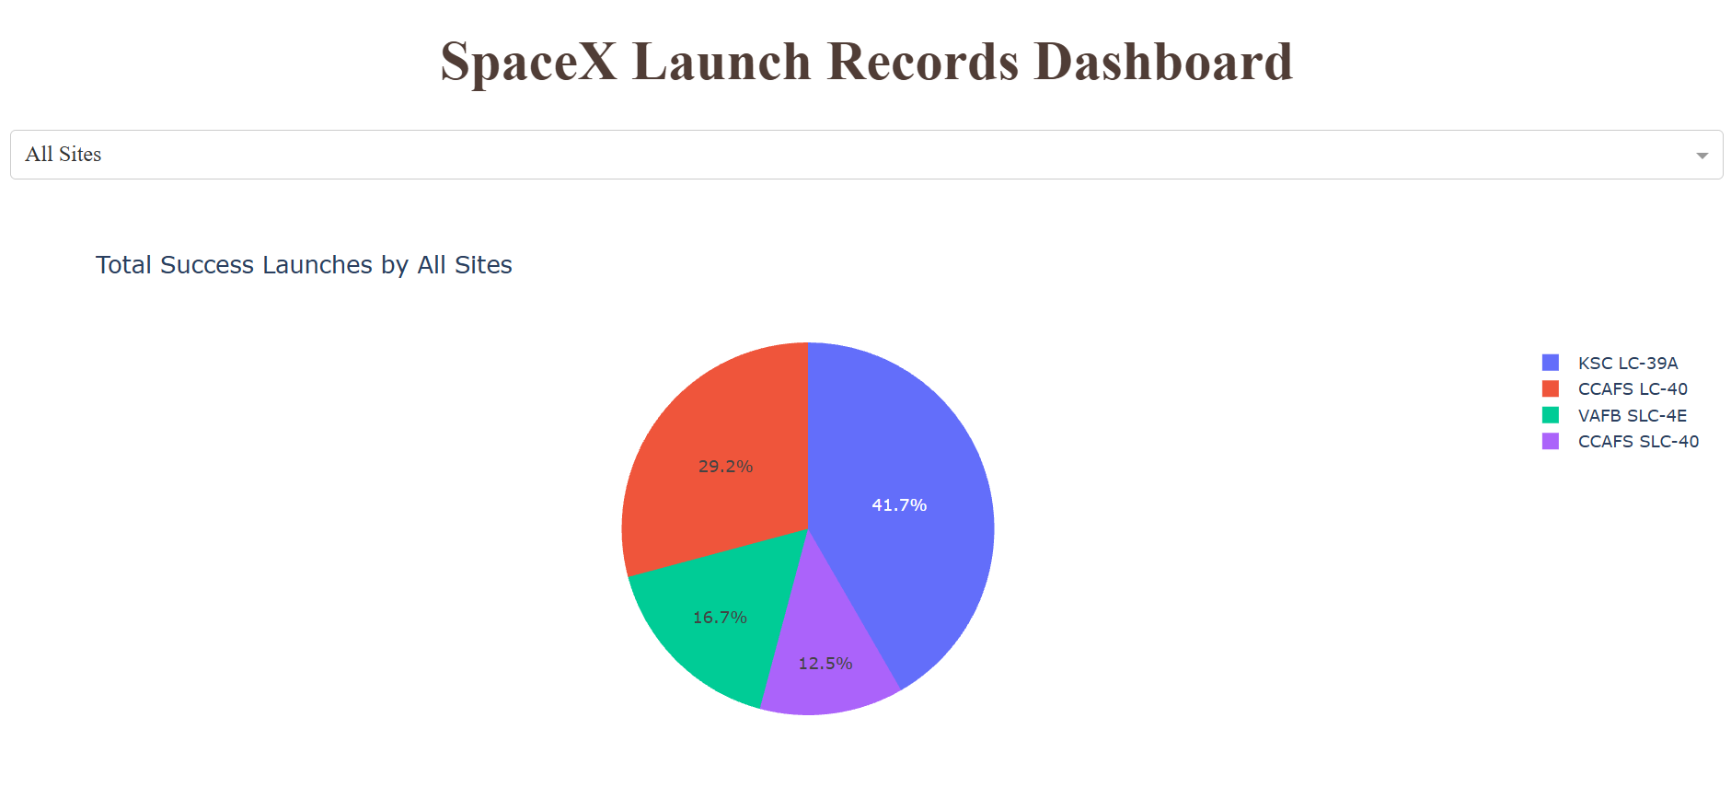
Total Launch Successes: All Sites

Slide 39

Site with Highest Launch Success
0 = failed launches, 1 = successful launches. CCAFS LC-40 is the most successful site with 73.1% launch success rate

Slide 40
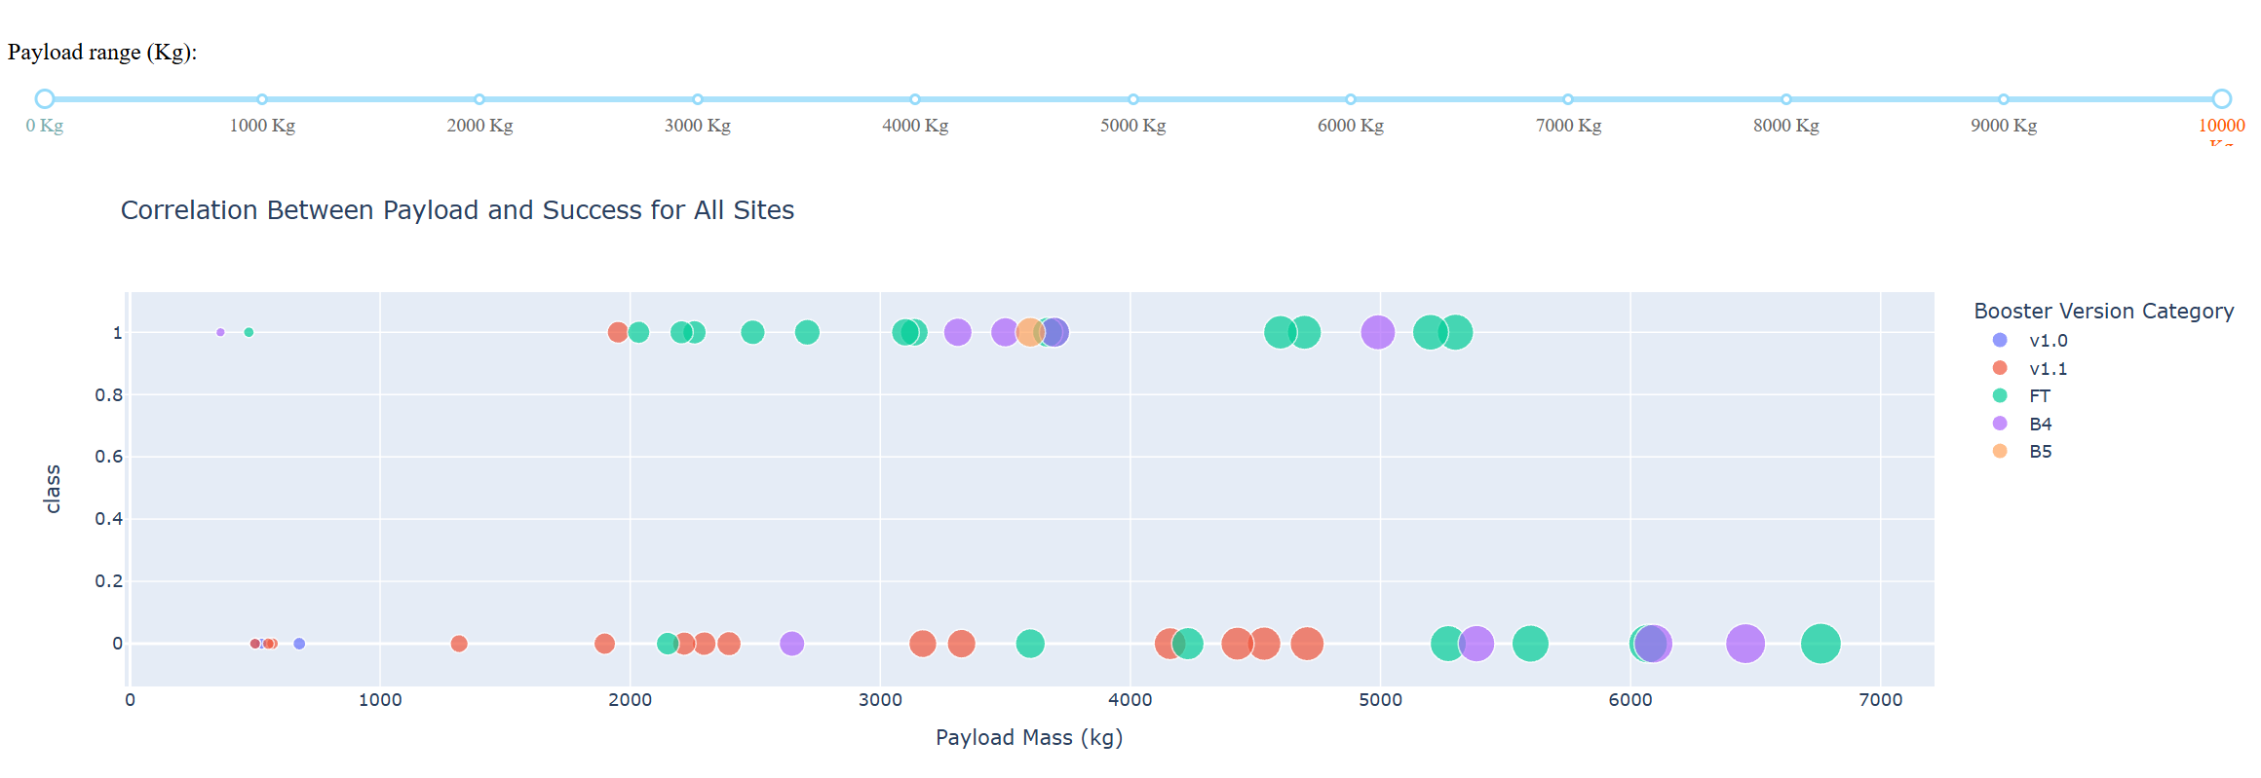
Payload vs Launch Success

Slide 41

Section 5

Slide 42
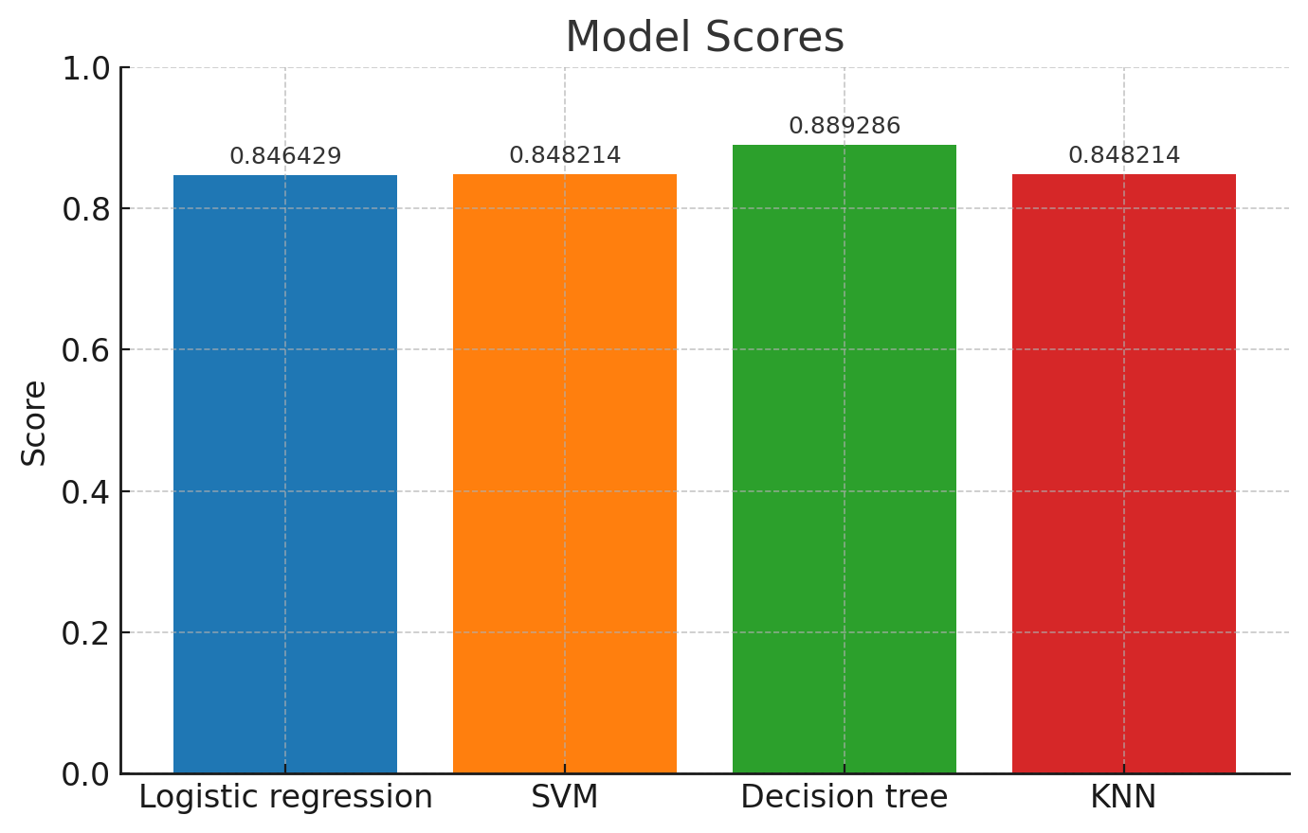
Classification Accuracy
Green bar = Decision Tree = Highest Classification accuracy

Slide 43

Confusion Matrix – Best Performing Model – Decision Tree
Confusion Matrices for all models were the same, indicating all model were very close to one another in terms of performance

Slide 44
Conclusions
We can conclude that we can predict Falcon 9 first stage will land successfully with 88% accuracy based on features in the launch data collected
Predictive models all performed very similarly. This could be due to the relatively small data set available for study
Prediction accuracy and model performance could be improved with additional data. Once more data is available, all predictive models should be re-evaluated to see if there is a true difference in the predictive power.

